Slide 1





MN Group
Maven CRM Sales Analysis

Slide 2

Team Members:
Nada Naseef Fahmy
Mariam Hossam Goda
- Data Cleaning & Modeling. - Sales Opportunities insights & Dashboard. - Sales Over Time insights & Dashboard.
Data Cleaning & Modeling.
Overview insights & Dashboard.
Nada Samer Beheery
Mariam Ramadan Abd Elrazek
- Performance by Teams insights & Dashboard.
- Sales by Region insights & Dashboard.

Slide 3
Table Of Contents
Introduction
Business questions
Analysis steps
Insights and Findings
Visualization
Recommendations
01
02
03
04
05
06

Slide 4


Introduction
The Sales Performance Dashboard tracks sales performance over multiple quarters, offering insights into sales agents’ activities and outcomes. It aims to improve sales tracking, enhance decision-making with data-driven insights, and boost sales efficiency by analyzing won vs. lost opportunities and identifying top-performing agents. It enables sales managers to monitor team performance and sales opportunities with ease.

Slide 5


Project Objective
To create an interactive Power BI dashboard that allows sales managers to track quarterly team performance, compare it to company averages, analyze sales trends, and identify top-performing agents, all to support data-driven decision-making and improve sales efficiency.

Slide 6
Business Questions
• How is the sales performance of the team for the given quarter?
• How is the team performing relative to the company average?
• What are the quarter-on-quarter sales trends of a team?
• Which geographic areas are the most active?
• How is each salesperson currently performing?
• What are the top selling products?

Slide 7
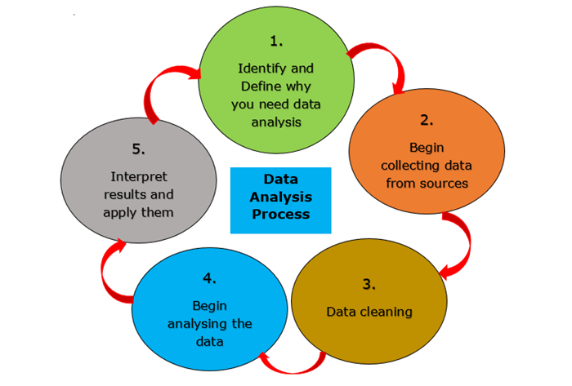
Analysis Steps

Slide 8


Data Collection
We have collected data files in CSV format from: Maven
Data set link : CRM_Sales

Slide 9

Data Cleaning
Common Issues Detected:
Missing Data
Errors
Duplicates
Data Type Mismatches: Certain columns may have incorrect data types (e.g., times stored as text).

Slide 10
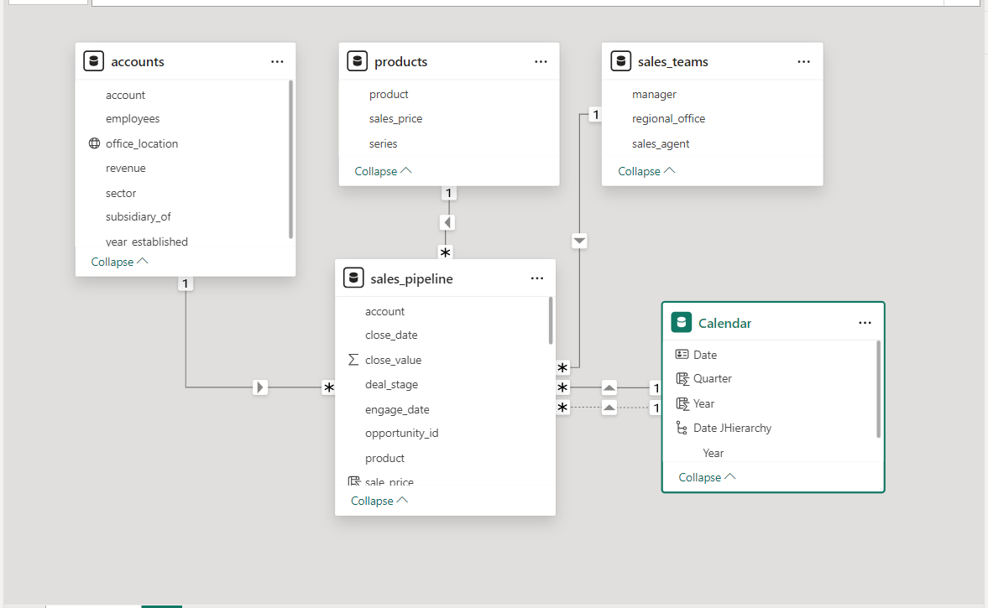
Data Modelling
We divided the data into:
● Fact table: sales_pipeline
● Dimension tables:
accounts
products
sales_teams
Calendar

Slide 11
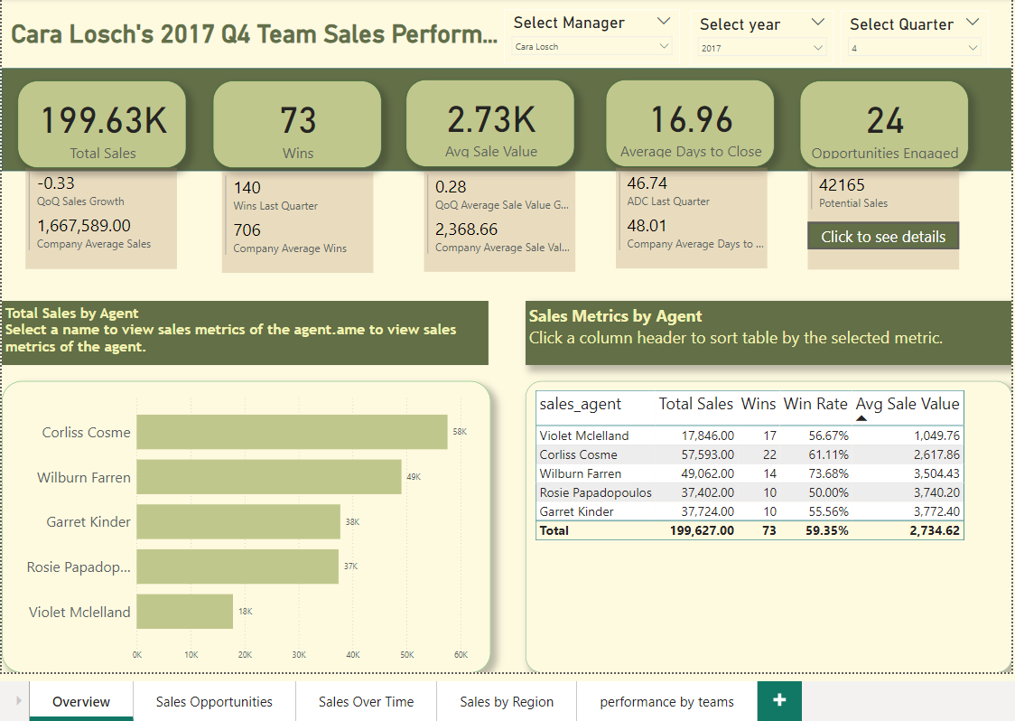
Overview page

Slide 12
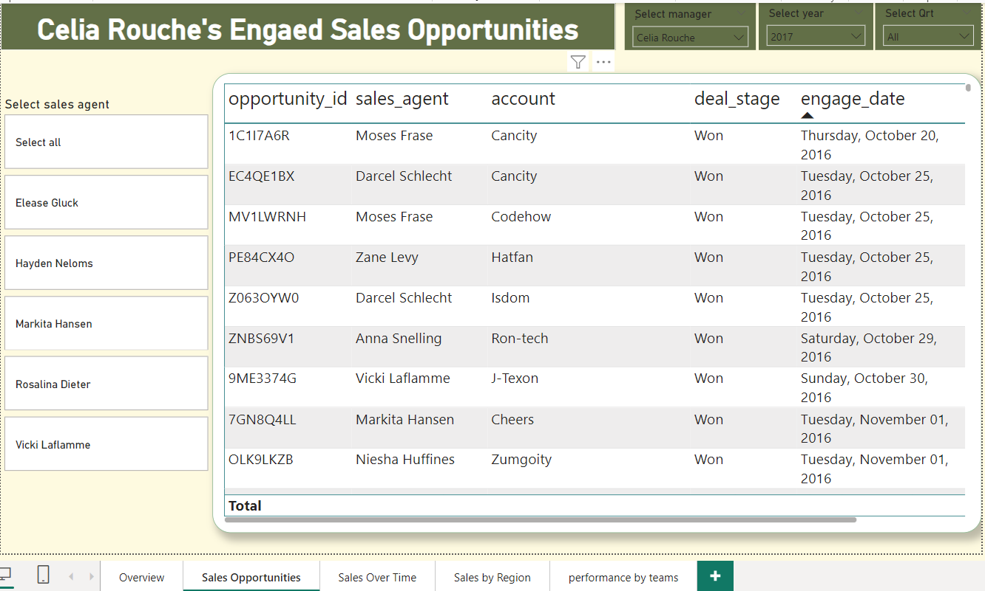
Sales Opportunities page

Slide 13
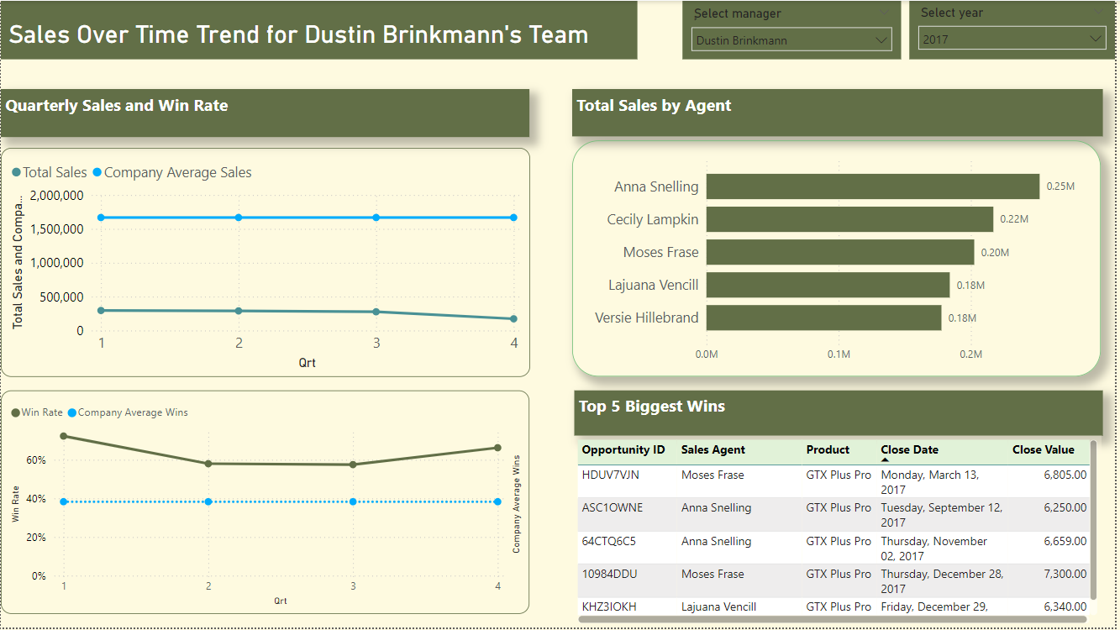
Sales Over Time page

Slide 14
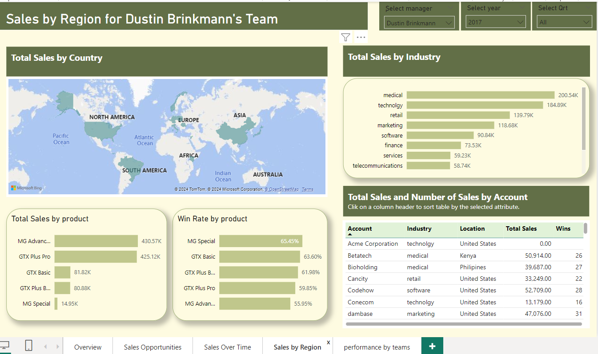
Sales by Region page

Slide 15
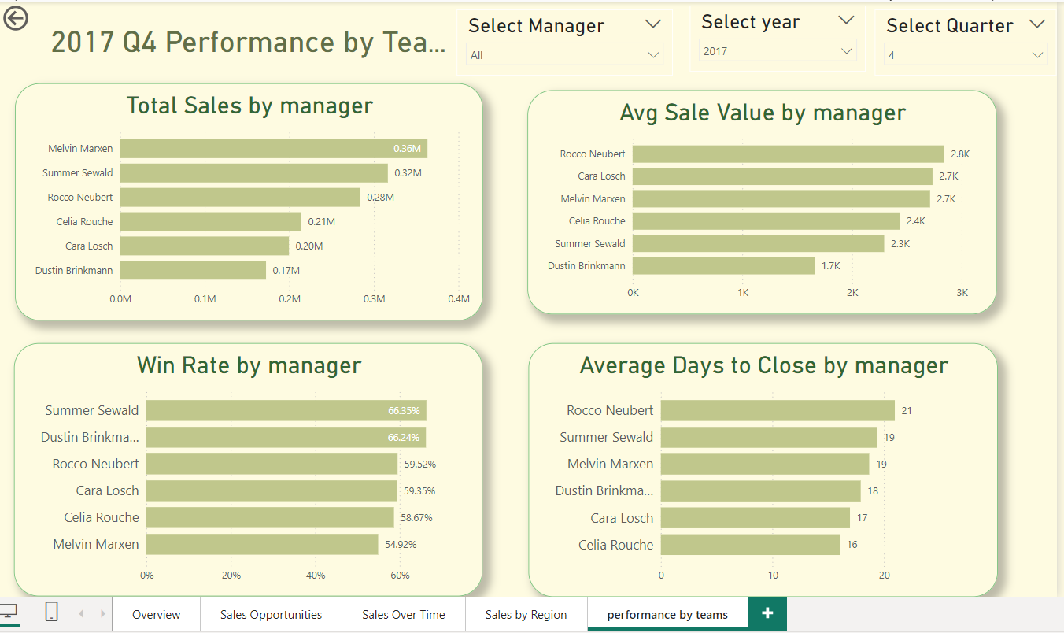
Performance by teams page

Slide 16


THANK You

